Slide 1
Chapter 5_ Lect2
Basic Computer Organization

Slide 2
INSTRUCTION SET COMPLETENESS
Instructions
A computer should have a set of instructions so that the user can
construct machine language programs to evaluate any function that is
known to be computable.
Instruction Types
  Functional Instructions
  - Arithmetic, logic, and shift instructions
  - ADD, CMA, INC, CIR, CIL, AND, CLA
  Transfer Instructions
  - Data transfers between the main memory
  and the processor registers
  - LDA, STA
  Control Instructions
  - Program sequencing and control
  - BUN, BSA, ISZ
  Input/Output Instructions
  - Input and output
  - INP, OUT
Computer System Architecture, Morris Mano

Slide 3
TIMING AND CONTROL
Timing and control
Control unit of basic computer
Instruction register (IR)
15
14 13 12
11 - 0
Other inputs
3 x 8
decoder
7 6 5 4 3 2 1 0
D
0
I
D
Control
Control
outputs
7
logic
gates
T
15
T
0
15 14 . . . . 2 1 0
4 x 16
decoder
4-bit
Increment (INR)
sequence
Clear (CLR)
counter
Clock
(SC)
Control unit implementation
Hardwired Implementation
Microprogrammed Implementation
Computer System Architecture, Morris Mano

Slide 4
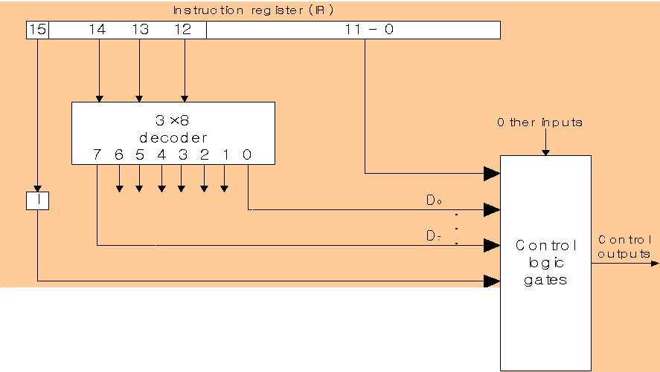
CONTROL UNIT HARDWARE (Hardwired)
• Inputs to the control unit come from IR where an instruction is stored.
• A hardwired control is implemented in the example computer using:
> A 3x8 decoder to decode opcode bits 12-14 into signals D0, ..., D7;
A flip-flop (I) to store the addressing mode bit in IR

Slide 5
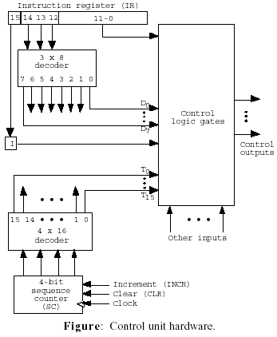
A 4-bit binary sequence counter (SC) to count from 0 to 15 to achieve time sequencing;
> A 4x16 decoder to decode the output of the counter into 16 timing signals, T0, ..., T15
A digital circuit with inputs
D0, ..., D7, T0, ..., T15, I,
and address bits in IR (11-0)
to generate control outputs
supplied to control inputs and select signals of registers , bus.

Slide 6
TIMING SIGNALS
Clocking principle: The binary counter goes through a cycle, 0000 → 0001 → 0010 → ... → 1111 → 0000. Accordingly only one of T0, ..., T15 is 1 at each clock cycle, T0 → T1 → T2 → ... → T15 → T0; all the other timing signals are 0.
By setting the clear input (CLR) of SC at a clock cycle, say T3, we can achieve a 4- cycle clock: T0 → T1 → T2 → T3 → T0.

Slide 7
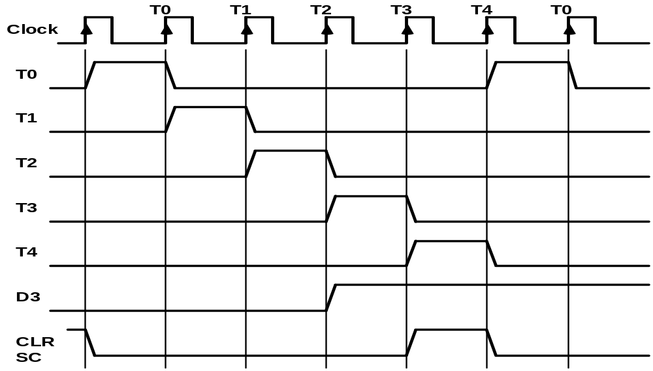
TIMING SIGNALS
Timing and control
- Generated by 4-bit sequence counter and 4x16 decoder
- The SC can be incremented or cleared.
- Example: T₀, T₁, T₂, T₃, T₄, T₀, T₁, . . .
Assume: At time T₄, SC is cleared to 0 if decoder output D3 is active.
D₃T₄: SC ← 0
Computer System Architecture, Morris Mano

Slide 8
5.5 Instruction Cycle
A computer goes through the following instruction cycle repeatedly:
do
1. Fetch an instruction from memory
2. Decode the instruction
3. Read the effective address from memory if the instruction has an indirect address
4. Execute the instruction until a HALT instruction is encountered

Slide 9
Instruction and Interrupt cycles
Interrupt Cycle
Instruction cycle
Interrupts Disabled
START
Fetch, decode
Next
Instruction
Execute
Instruction
Interrupt
cycle
Interrupts Enabled
HALT

Slide 10

Instruction Fetch
  Instruction Fetch : T0, T1
    T0 = 1
      1) Place the content of PC onto the bus by making the bus selection inputs S₂S₁S₀=010
      2) Transfer the content of the bus to AR by enabling the LD input of AR
Continue indefinitely unless HALT instruction is encountered
  T1 = 1
    1) Enable the read input memory
    2) Place the content of memory onto the bus by making S₂S₁S₀= 111
    3) Transfer the content of the bus to IR by enable the LD input of IR
    4) Increment PC by enabling the INR input of PC

Slide 11
INSTRUCTION CYCLE
Instruction Cycle
BC Instruction cycle: [Fetch Decode [Indirect] Execute]*
• Fetch and Decode
T0: AR ← PC (S₀S1S2=010, T0=1)
T1: IR ← M [AR], PC ← PC + 1 (S0S1S2=111, T1=1)
T2: D0, . . . , D7 ← Decode IR(12-14), AR ← IR(0-11), I ← IR(15)
T1
S2
T0
S1
Bus
S0
Memory
7
unit
Address
Read
AR
1
LD
PC
2
INR
IR
5
LD
Clock
Common bus

Slide 12
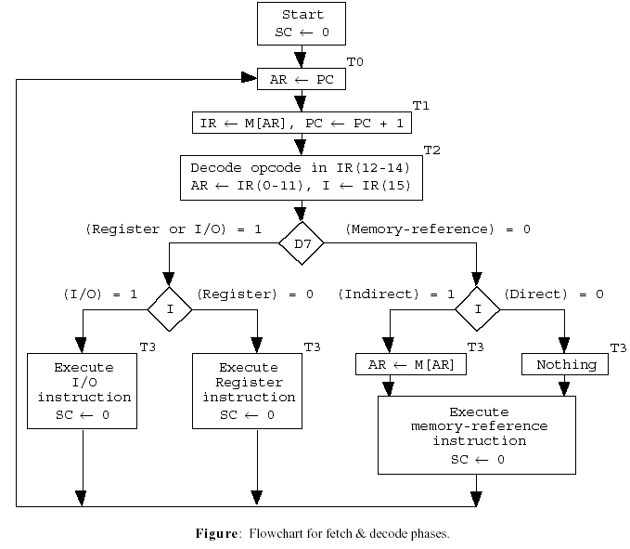

Slide 13
Instruction Cycle
At T3, microoperations which take place depend on the type of instruction. The four different paths are symbolized as follows,
Control function Microoperation
D7`IT3: AR ← M[AR], indirect memory transfer
D7`I`T3: Nothing, direct memory transfer
D7I`T3: Execute a register-reference instruction
D7IT3: Execute an I/O instruction
When D7`T3 = 1 (At T3 & IR(12-14) ≠ 111), the execution of memory-reference instructions takes place with the next timing variable T4.

Slide 14
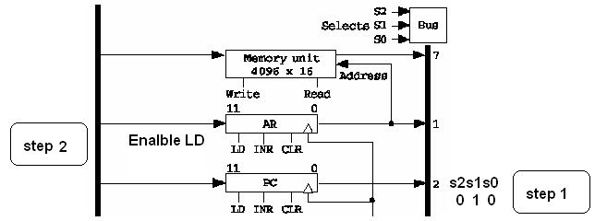
Address transfer between PC and AR
T0: Since only AR is connected to the address inputs of memory, the address of instruction is transferred from PC to AR.
1. Place the content of PC onto the bus by making the bus selection inputs S2S1S0 = 010.
2. Transfer the content of the bus to AR by enabling the LD input of AR ( AR ←PC).

Slide 15
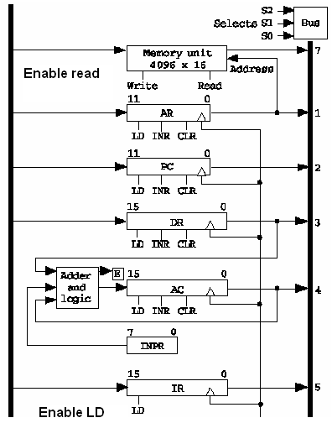
Data transfer between Memory and IR
T1: The instruction read from memory is placed in IR. At the same time, PC is incremented to the address of the next instruction.
1. Enable ‘read input’ of the memory.
2. Place the content of memory onto the bus using the bus selection inputs S2S1S0 = 111. (Note that the address lines are always connected to AR, and the next instruction address has been already placed in AR.)
3. Transfer the content of the bus to IR by enabling LD input to IR
(IR ←M[AR]).
4. Increment PC by enabling the INR input of PC ( PC ←PC + 1 ).

Slide 16
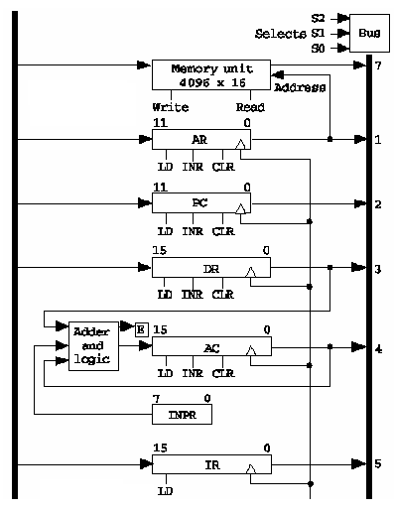
Decoding at T2
T2: The operation code in IR is decoded; the indirect bit is transferred to I; the address part of the instruction is transferred to AR.

Slide 17

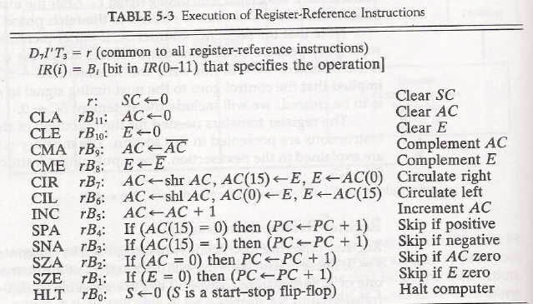
REGISTER-REFERENCE INSTRUCTIONS
• The 12 register-reference instructions are recognized by I = 0 and D7 = 1 (IR(12-14) = 111). Each operation is designated by the presence of 1 in one of the bits in IR(0-11). Therefore D7I`T3 ≡ r = 1 is common to all register-transfer instructions.

Slide 18
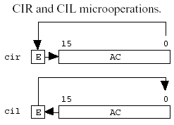
For example
B7 = 007 (in hexadecimal)., In binary this is equivalent to: 0000 0000 0111 (CIR)
B6 = 006 (in hexadecimal)., In binary this is equivalent to: 0000 0000 0110 (CIL)

Slide 19
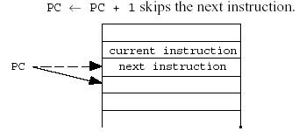
For example
B3 = 008 (in hexadecimal)., In binary this is equivalent to: 0000 0000 1000 (Complement E)
B4 = 010 (Bi=bit in position i =4) in binary is 0000 0001 0000 (skip if positive)

Slide 20
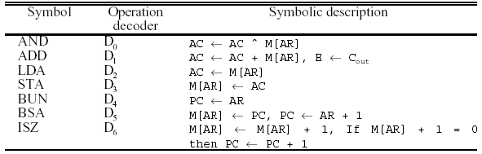
5.6 Memory Reference Instructions
• Opcode (000 - 110) or the decoded output Di (i = 0, ..., 6) are used to select one memory-reference operation out of 7.

Slide 21
Memory Reference Instructions
Since the data stored in memory cannot be processed directly (the memory unit is not connected to the ALU), the actual execution in the bus system require a sequence of microoperations.
(Note that T0-T2 for fetch an instruction; T3 for AR ← M[AR] if indirect memory addressing.

Slide 23
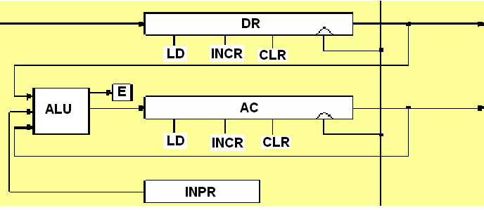
Computer Registers
      Accumulator(AC) : takes input from ALU
        The ALU takes input from DR, AC and INPR :
        ADD DR to AC, AND DR to AC
      Note) Input register is not connected to the bus.
      The input register is connected only to the ALU

Slide 24
AND to AC
AND to AC: Logical AND operation between AC and the memory word specified by AR.
(Note that T0-T2 for fetch an instruction; T3 for AR ← M[AR] if indirect memory addressing.
Need 2 more cycles for the AND logical operation since only DR is connected to ALU.)
D0T4: DR ← M[AR]
D0T5: AC ← AC ˆ DR, SC ← 0
  SC – start counter

Slide 25
ADD to AC
ADD to AC: Arithmetic addition operation between AC and the memory word specified by AR.
D1T4: DR ← M[AR]
D1T5: AC ← AC + DR, SC ← 0

Slide 26
Load to AC
LDA: Load to AC.
(Need 2 cycles since AC input is not connected to the bus.)
D2T4: DR ← M[AR]
D2T5: AC ← DR, SC ← 0

Slide 27
Store AC
STA: Store AC.
D3T4: M[AR] ← AC, SC ← 0

Slide 28
BUN: Branch unconditionally
Transfers the program to the instruction specified by AR. (Note that the branch target must be in AR beforehand.)
D4T4: PC ← AR, SC ← 0

Slide 29
Branch unconditionally
BUN: Branch unconditionally. Transfers the program to the instruction specified by AR. (Note that the branch target must be in AR beforehand.)
D4T4: PC ← AR, SC ← 0

Slide 30
BSA :Branch and save return address
This instruction is useful for branching to a position of the program called a subprogram
BSA: Branch and save return address. Branch to address AR and save PC address.
•BSA is used to implement a subroutine call. The indirect BUN instruction at the end of the subroutine performs the subroutine return.

Slide 31
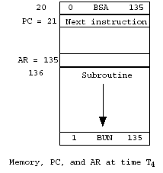
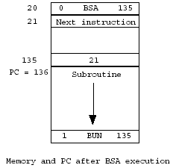
Branch and save return address
M[135] ←21 , PC ←135+1= 136
Return address

Slide 32
Branch and save return address
Note that the above microoperations require 2 cycles.
D5T4: M[AR] ← PC, AR ← AR + 1 (increment, INR AR)
D5T5: PC ← AR, SC ← 0

Slide 33
Increment and skip if zero
ISZ: Increment and skip if zero.
Programmer usually stores a negative number in the memory word (in two’s complement form).
As this negative number is repeatedly incremented by one, it eventually reaches zero. At that time PC is incremented by one in order to skip the next instruction.

Slide 34
Increment and skip if zero
increment:
M[AR] ←M[AR] + 1, if (M[AR] + 1 = 0) then PC ← PC + 1
increment and skip if zero requires 3 cycles.
  D6T4: DR ← M[AR]
  D6T5: DR ← DR + 1
  D6T6: M[AR] ← DR, if DR=0 then
  PC ← PC + 1, SC ← 0
• The ISZ instructions is used to implement a loop.

Slide 35
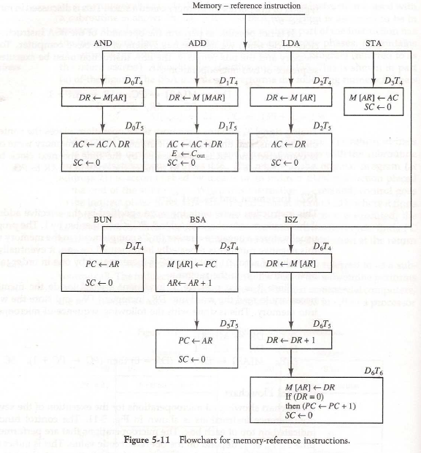

Slide 36
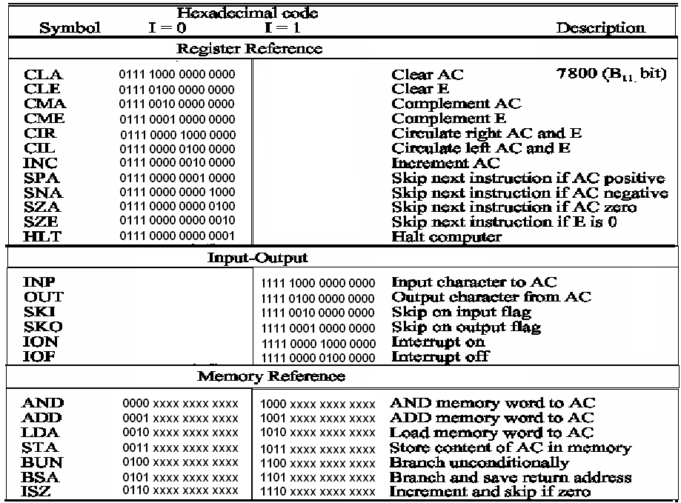
Computer Instruction
3 Instruction Code Formats :
1-Register-reference instruction
      7xxx (7800 ~ 7001) : CLA, CMA, ….
    2-Input-Output instruction
      Fxxx(F800 ~ F040) : INP, OUT, ION, SKI, ….
15 14 12 11 0
0 1 1 1 Register Operation
15 14 12 11 0
1 1 1 1 I/O Operation
3-Memory-reference instruction
  Opcode = 000 ∼ 110
    I=0 : 0xxx ~ 6xxx, I=1: 8xxx ~Exxx
I=0 : Direct,
I=1 : Indirect
15 14 12 11 0
I Opcode Address

Slide 37
5.7 IO and Interrupt
Input-output
Serial
registers and
terminal
communication
Computer
interface
flip-flops
Printer
Receiver
OUTR
FGO
interface
AC
Keyboard
Transmitter
INPR
FGI
interface
Serial Communications Path
Parallel Communications Path

Slide 38
5.7 IO and Interrupt
Input-Output Configuration :
  Input Register(INPR), Output Register(OUTR)
    These two registers communicate with a communication interface serially and with the AC in parallel
    Each quantity of information has eight bits of an alphanumeric code

Slide 39
IO and Interrupt
Input Flag(FGI), Output Flag(FGO)
  FGI : set when INPR has information, clear when INPR is empty
  FGO : set when operation is completed, clear when output device is active (for example a printer is in the process of printing)

Slide 40
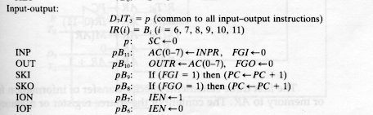

Slide 41
IO instructions
These instructions are executed with the clock transition associated with timing signal T3
For these instructions, D7=1 and I=1
The control function is distinguished by one of the bits in IR(6-11)

Slide 42
Program Interrupt
Program Interrupt
  Two I/O Transfer Modes
    1) Programmed I/O
    2) Interrupt-initiated I/O (FGI FGO)
IEN: interrupt enable flip-flop
R: interrupt flip-flop

Slide 43
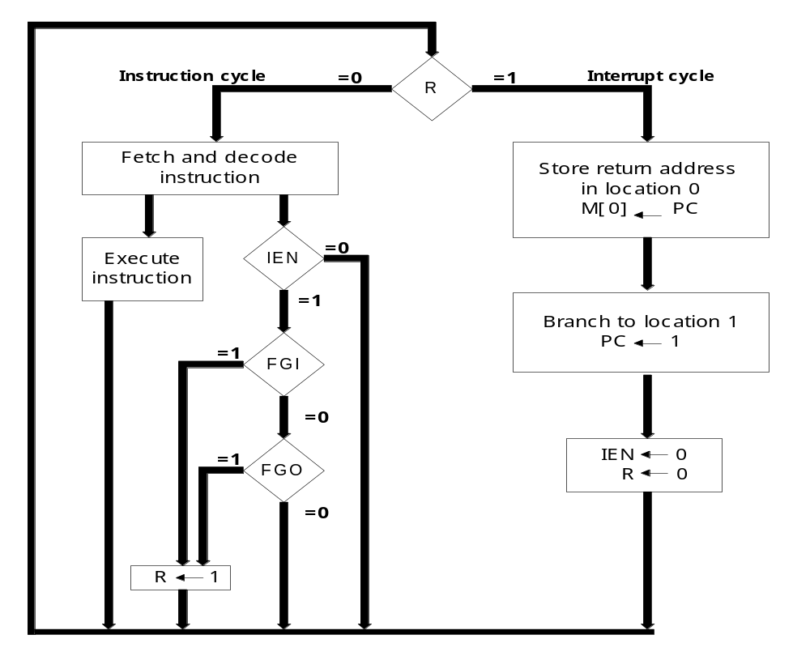


Slide 44
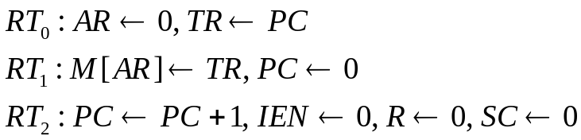
Program Interrupt
Demonstration of the interrupt cycle :
  The memory location at address 0 is the place for storing the return address
  Interrupt Branch to memory location 1
  Interrupt cycle IEN=0
0
PC = 1
255
256
1120
256(return address)
0 BUN 1120
Main Program
Interrupt
Service Routine
1 BUN 0
Interrupt
Here
Save Return
Address(PC) at 0
Jump to 1(PC=1)

Slide 45
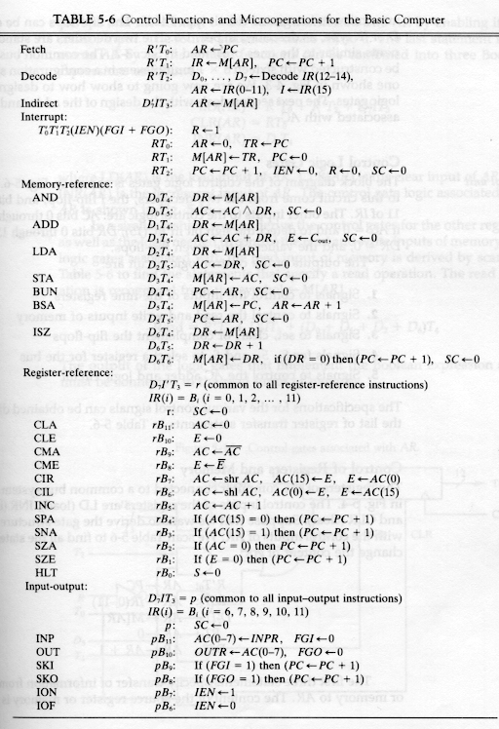
Mano's Computer: RTL

